Slide 1

Presentation on
Java Project
Title: Online Examination System
THE JAVA QUIZ-RACE AGAINST THE CLOCK
Presented by
Shivani Chauhan
Guided by
Dr. Ranjith Kumar(26108)
1

Slide 2

content
Introduction 9.Existing Systems
Why online examination 10. Conclusion
Modules
Problem Definition
Problem Statement
Proposed System
7. System Analysis
8. Advantages
2

Slide 3

Introduction
Online Exams is being launched because a need for a destination that is beneficial for both institutes and students. With this site, institutes can register and host online exams. Students can give exams and view their results. This site is an attempt to remove the existing flaws in the manual system of conducting exams.
Purpose
Online Exams System fulfills the requirements of the institutes to conduct the exams online. They do not have to go to any software developer to make a separate site for being able to conduct exams online. They just have to register on the site and enter the exam details and the lists of the students which can appear in the exam. Students can give exam without the need of going to any physical destination. They can view the result at the same time. Thus the purpose of the site is to provide a system that saves the efforts and time of both the institutes and the students.
3

Slide 4

Why online Examination
Stored Repository of exams
Auto grading
Flexible
Time Saver
Security
General problem with time for students
Develop a system which allows the faculty to create, modify and store questions which can be grouped together to form sections and these sections can be grouped together to form/ examinations.
4

Slide 5

MODULE
Login Module
Rules Module
Quiz Module
Score Module
5

Slide 6
Problem Definition
Online Examination is very helpful to users. The aim of this project is to provide quick, immediate and easy way to appear the exam. It can provide special advantages to the students/applicants. The online examination system can automatically add the marks allocated in each question to determine the total mark for the questions. A time limit can be set for the questions.
If we practice on the Timer based Quiz then on that we are more attentive.
6

Slide 7

Problem Statement
Conductors required a long time to conduct examination in a traditional way. It is not possible to take examination of mass students. Examiners are not able to maintain the hard copy record of student in large quantity. For examiner, manipulation of student record is difficult. And have the problem will not born in online examination system.
After tackling with these problems, I feel that we need to create a virtual examination system because: It is easy to conduct. Give speed and accuracy to give examination and show result. Required less manpower to execute the examination.
7

Slide 8

Proposed System
In comparison to the present system the proposed system will be less time consuming and is more efficient.
Result will be very precise and accurate and will be declared in very short span of time because calculation and evaluations are done by the simulator itself.
The proposed system is very secure as no chances of leakage of question paper as it is dependent on the administrator only.
8

Slide 9
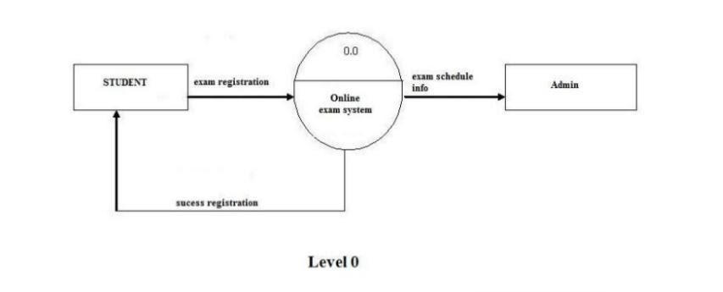
System Analysis
A DFD can be categorized in the following forms:
Context diagram: An overview of an organizational system that shows the system boundaries, external entities that interact with the system and the major information flows between the entities and the system. In this diagram, a single process represents the whole system.
9

Slide 10

Advantages of online Examination
Physical pressure at a given location is absolutely not necessary.
Result available instantly.
Easy Accessibility.
User Friendly.
Secure because authentication.
Online exams – Convenience, Security and Flexibility.
Available at a reduced cost.
Accuracy in checking the answer, calculating result.
10

Slide 11

EXISTING SYSTEM
A number of online examination system software are available today.
The system of online exams has been widely adopted by a good number of organizations and universities.
The tasks of maintaining records, score cards, student details, question papers and so on is very easily managed by the systems.
11

Slide 12

Conclusion
The key concept is to minimize the amount of paper and convert all forms of documentation to digital form. It can observe that the information required can be obtained with ease and accuracy in the computerized system. The user with minimum knowledge about computer cab be easily able operate the system easily. The system also produces brief result required by the management.
12

Slide 13

THANK YOU
The java Quiz!
Race against the Clock
Let’s Learn!
13

